Slide 1

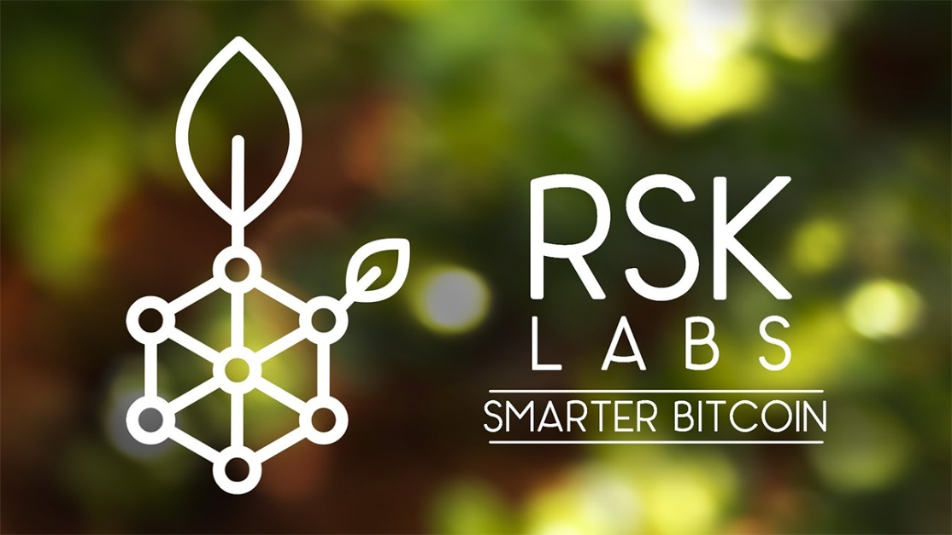
Smart Contracts for Bitcoin with RSK
Introduction to Rootstock, Set up an RSK node
Simeon Mandazhiev
Assistant Trainer
Academy School of Blockchain
http://kingsland.academy

Slide 2


Table of Contents
What is RSK
Introduction to Rootstock
Merge Mining
Smart contracts with RSK
RSK Node
Deploying Smart Contract with Truffle

Slide 3


What is RSK
First Open Source Smart contract platform powered by the bitcoin network
Add value and functionality to the Bitcoin ecosystem
Enabling smart-contracts
Near instant payments
Higher-scalability
Rewards the Bitcoin miners via merge-mining

Slide 4
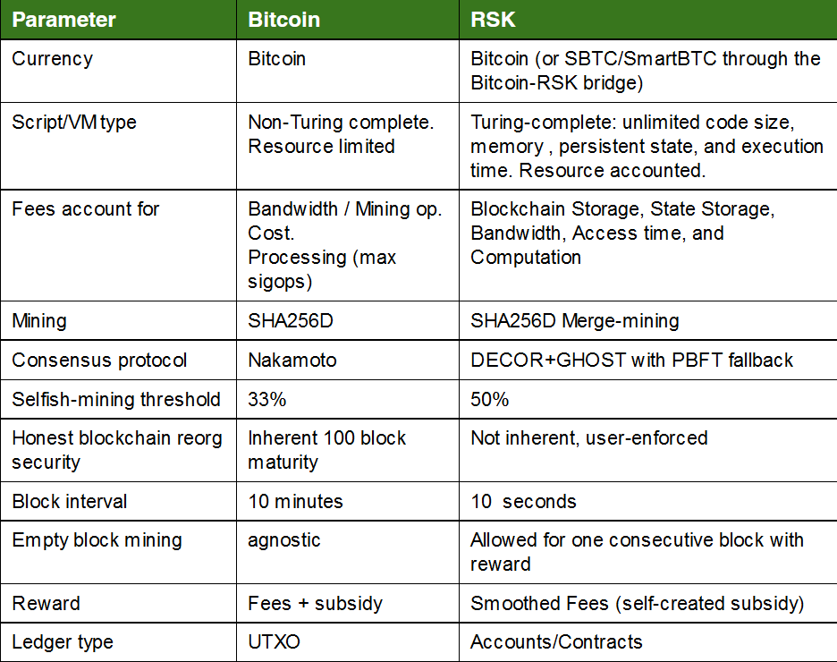
RSK vs Bitcoin
Block interval:
BTC 10 min
RSK 10 sec
Ledger type:
BTC UTXO
RSK Accounts/Contracts
Mining:
BTC SHA256D
RSK SHA256D Merge-mining
Transaction volume is the same than that of PayPal: 100 transactions per second
Platforms to run Smart Contracts
https://github.com/Overtorment/awesome-smart-contracts

Slide 5
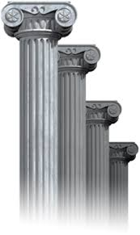
RSK’s Pillars
Full compatibility with leading smart contract platforms
Bitcoin used as fuel to run the smart contracts (through the Bitcoin-RSK Bridge)
SBTC are "transfered" from BTC to SBTC
The bridge account (an smart contract) in RSK mainnet, already have a balance of 21M of SBTC
They are released when there is a transfer from BTC to RSK
Security ensured by Bitcoin Network merge-mining
Global Federation

Slide 6

RSK Official Start
First Bitcoin-powered smart contract platform
Nearly 3 years of preparation
First mainnet version codenamed Bamboo released in Dec 2017
RSK Labs has mined its Genesis Block at 1:41 am CST on Jan 4 2018
Vulnerability Bounty Program https://uploads.strikinglycdn.com/files/a8fa29df-ec27-498a-b83f-33d63bc6b5de/RSK%20Vulnerability%20Bounty%20Program.pdf

Slide 7
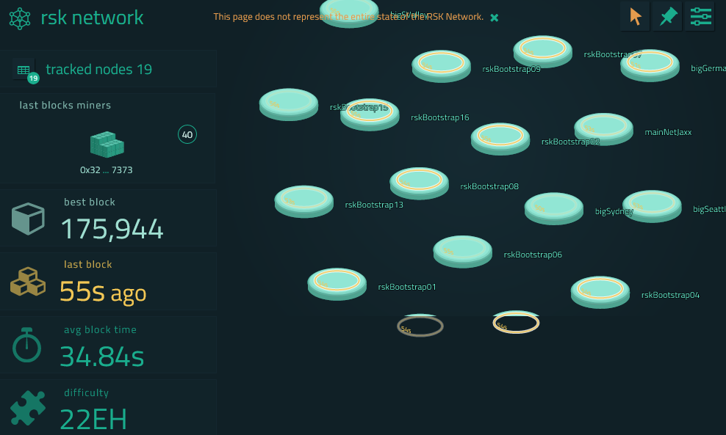
RSK Stats and Explorer
Live Demo: https://stats.rsk.co/
https://explorer.rsk.co/home

Slide 8
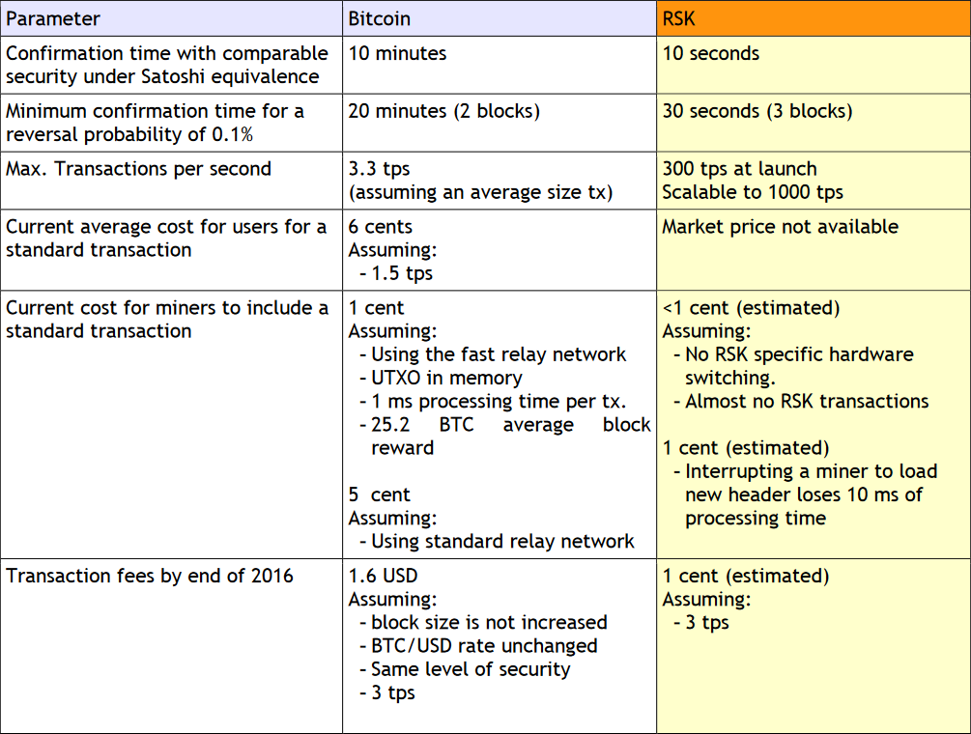
RSK as a low-cost BTC payment network
Max tx. per second:
BTC 3.3 tps
RSK 300 tps
Tx. fees:
BTC 10 USD
RSK 1 cent

Slide 9
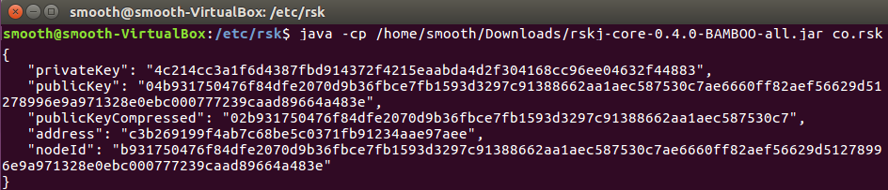
Generate RSK Keys
Demo: generate keys
https://github.com/rsksmart/rskj/blob/master/rskj-core/src/main/java/co/rsk/GenNodeKeyId.java

Slide 10
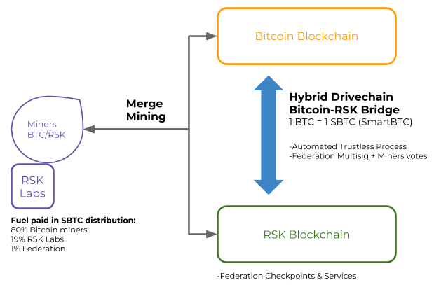
How RSK System Works?
RSK use elliptic curve cryptography
Public Key for BTC can be used for RSK
EC Private Key
EC Public Key
BTC Address
RSK Address

Slide 11

Governance Model
RSK governance model aims to represent all actors of the community (5 seats)
Miners vote with hashing power (1 vote)
Bitcoin and RSK users will vote with proof-of-stake (1 vote)
Exchanges and web-wallets will vote though the Federation (1 vote)
RSK and Bitcoin Core developers will have a special threshold voting system (1 vote)
Non-profit established Bitcoin institution

Slide 12

Rootstock
Bitcoin Smart Contract Platform

Slide 13


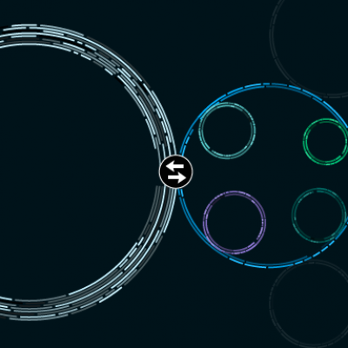
What is Rootstock
Rootstock (rüt-ˌstäk) - A horizontal, usually underground stem that often sends out roots and shoots from its nodes
Rootstock (RSK) smart contract platform that is connected to the Bitcoin blockchain through sidechain technology

Slide 14
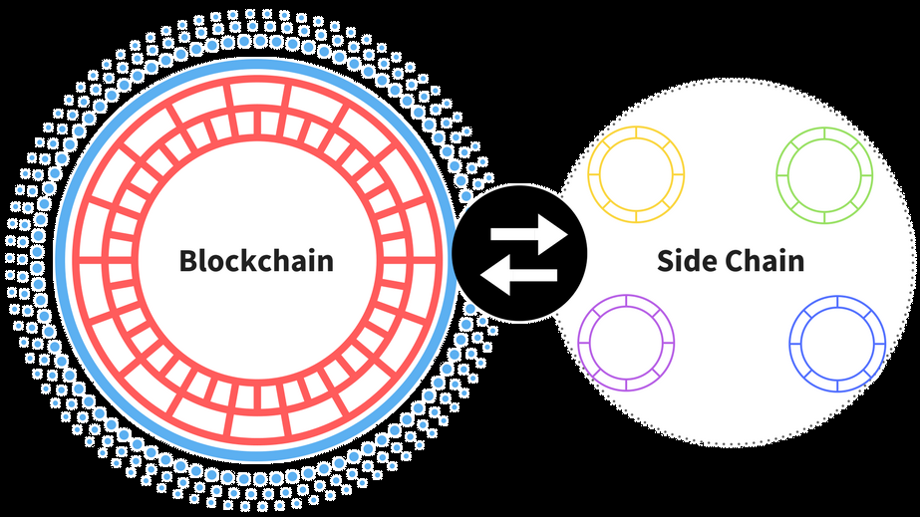
About Rootstock
The smart contracts aren't deployed on the Bitcoin blockchain itself
Users can send Bitcoin directly onto the Rootstock chain through a 2-way peg
Which are then converted into smart Bitcoins on the Rootstock blockchain
1 Rootoshi == 1 Satoshi
1 wei = ???
RSK coins can be used to deploy or to interact with smart contracts and dApps on the RSK blockchain

Slide 15
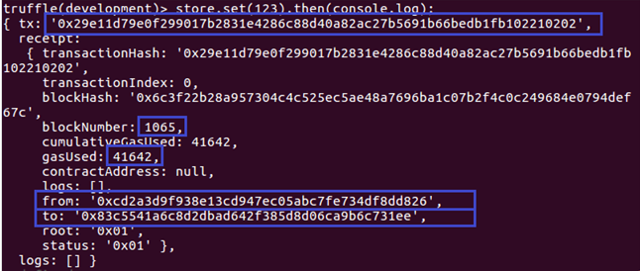

Smart Contract in RSK
RSK platform follows a similar ledger structure like Ethereum
It’s based on accounts rather than UTXOs
RSK Smart Contracts world is like Ethereum
The one wei is 10^-18 of one BTC
tx format is exactly like the one in Ethereum
Each user controls one or more accounts
Each account is controlled by one private key of the ECDSA scheme
Transactions can deduct funds from an account, and transfer them to other accounts or smart-contracts

Slide 16
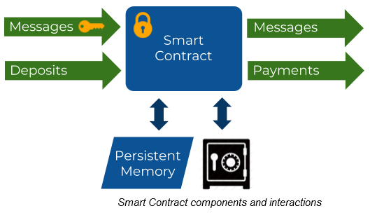
Smart Contract in RSK
The Smart-contract receives and sends 2 types of signals
Messages
Deposits/Payments
Smart-contract has it's own memory and a vault where SBTC can be stored

Slide 17

Exercise: Install RSK Node and Deploy Smart Contract
RSK Node
Java implementation of the RSK node

Slide 18

Summary
RSK is first Open Source Smart contract platform powered by the bitcoin network
Merge Mining allows to mine for more than one blockchain at the same time
Rootstock (RSK) is smart contract platform connected to the Bitcoin blockchain through sidechain
RSK platform follows a similar ledger structure like Ethereum
Smart-contract receives and sends 2 types of signals: Messages and Payments

Slide 19
Smart Contracts for Bitcoin with RSK
http://www.kingsland.academy

Slide 20
Resources
RSK: https://www.rsk.co/
RSK Node: https://github.com/rsksmart/rskj
Smart Contracts Platforms: https://github.com/Overtorment/awesome-smart-contracts

Slide 21

Merge-Mining
Bitcoin miners can mine both Bitcoin and RSK at the same time
With the same hardware and consuming the same electricity
The same hash calculation secures both blocks

Slide 22
Smart-contract in RSK
The one wei is 10^-18 of one BTC
tx format is exactly like the one in Ethereum
to sync a RSK node you must only sync the RSK blockchain (testnet or mainnet), not the BTC blockchain

